Slide 1
Job Scheduling in cloud environment
Using ant Colony Optimization Algorithms

Slide 2
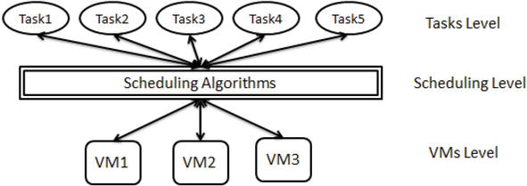
Job Scheduling in cloud
Cloud computing provides scalable and on-demand access to computing resources. One of the core challenges in cloud computing is job scheduling, which involves assigning jobs (tasks or processes) to available computing resources (like virtual machines or containers) in an optimized manner. Efficient job scheduling directly impacts the performance, cost, energy consumption, and Quality of Service (QoS) in cloud environments.

Slide 3
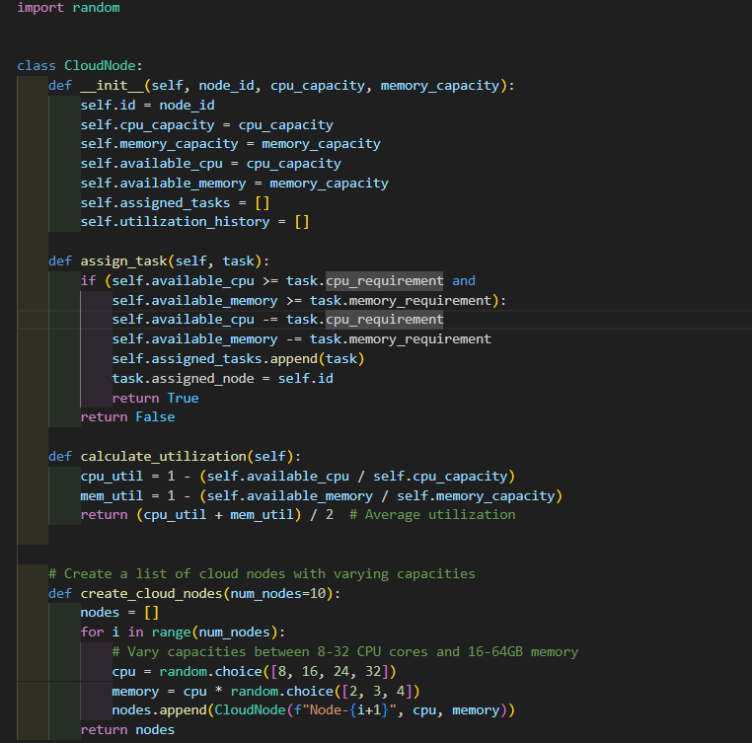
cloud environment
This module defines the CloudNode class used to represent a computing node in a cloud environment. Each node has:
A unique ID, CPU and memory capacities
Tracks available resources and assigned tasks
Provides a method to calculate average resource utilization (CPU and memory)
assign_task(task): Assigns a task if resources are sufficient
calculate_utilization(): Computes average of CPU and memory usage
create_cloud_nodes(num_nodes): Generates a list of cloud nodes with random CPU and memory capacities, simulating heterogeneity

Slide 4
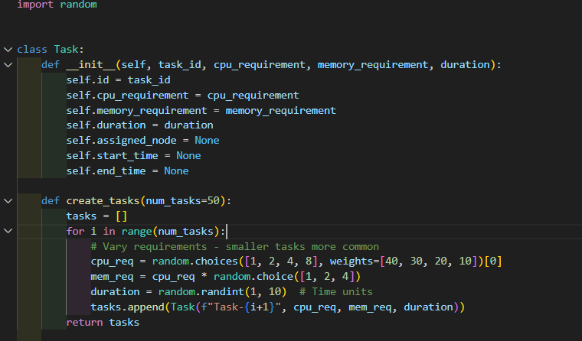
cloud environment
This module defines the Task class, representing individual tasks to be scheduled on cloud nodes. Each task includes:
A unique ID, CPU and memory requirements, and a duration
Metadata for tracking its assigned node and execution time (start and end)
create_tasks(num_tasks): Generates a list of tasks with randomized but weighted resource requirements, simulating a realistic workload where smaller tasks are more frequent.

Slide 5
Objectives of Job Scheduling
Job scheduling techniques aim to:
Minimize Makespan: Reduce total job completion time.
Maximize Resource Utilization: Ensure all computing resources are efficiently used.
Balance Load: Distribute tasks evenly across resources.
Reduce Energy and Cost: Minimize computation costs and energy usage.
Meet QoS and SLA Requirements: Ensure deadlines, availability, and throughput.

Slide 6
Job Scheduling Techniques
Hybrid Scheduling Techniques
GA + ACO
Ant Colony Optimization (ACO)
Heuristic-Based Scheduling Algorithms

Slide 7
Heuristic-Based Scheduling Algorithms
Classical ACO (Ant System - AS)
The original algorithm; all ants contribute to pheromone updates. Simple but slow.
Elitist Ant System (EAS)
Adds extra pheromones for the best solution to accelerate convergence.
ASrank
Ranks ants by solution quality and updates pheromone with a weighted contribution, balancing search efficiency.
Max-Min Ant System (MMAS)
Limits pheromone values and updates only the best ant's path, avoiding stagnation and ensuring stability.
Ant Colony System (ACS)
Introduces local pheromone updates and a probabilistic rule to promote exploration and faster convergence.

Slide 8
Hybrid Scheduling Techniques
ACO-GA
Combines ACO's exploitation with GA's exploration. Improves global search.

Slide 9
Ant Colony Optimization (ACO)
is a nature-inspired algorithm used to solve complex problems like scheduling, routing, and optimization. It is based on how real ants find the shortest path between their nest and a food source.
Artificial Ants Build Solutions:
Each ant builds a possible solution step by step (e.g., assigning tasks to machines).
Pheromone Trails(τ):
The system keeps a memory (pheromone) of how good each decision was in the past.
Better solutions leave stronger pheromone trails, which influence future ants.

Slide 10
Ant Colony Optimization (ACO)
Heuristic Information (η):
Problem-specific knowledge (e.g., execution time or resource availability).
Combined with pheromone to guide the ant's decision.
Transition Probability:
Ants probabilistically choose the next component of their solution based on pheromone strength and heuristic value
Decision Making:
Pheromone strength (past experience)
Heuristic information (e.g., estimated time or cost)
Pheromone Update: After all ants finish, pheromone levels are updated
Good solutions add pheromone.
All trails slowly evaporate to avoid getting stuck.

Slide 11
Parameters in ACO
Pheromone Influence - Alpha (α):
Controls how much importance is given to the pheromone trail when an ant chooses a path. Typical range: 0 to 5
If α is high: Ants follow pheromone more strongly → faster convergence, but may miss better paths.
If α is low: Ants rely less on pheromone → more random choices and exploration.

Slide 12
Parameters in ACO
Heuristic Influence - Beta (β):
Controls how much importance is given to the heuristic information (like cost, time, distance). Typical range: 1 to 10
If β is high: Ants prefer paths that seem good based on the heuristic → better decisions early on.
If β is low: Ants focus more on pheromone → may ignore helpful heuristics.

Slide 13
Parameters in ACO
Pheromone Evaporation Rate (ρ, rho):
The rate at which pheromone fades away over time.
Between 0 and 1 (e.g., 0.1 means 10% is lost per round)
If ρ is high: Pheromone fades fast → encourages exploration (avoids sticking to old paths).
If ρ is low: Pheromone stays longer → stronger memory, faster convergence but may get stuck.

Slide 14
Parameters in ACO
Number of Ants (m):
The number of ants that build solutions in each iteration.
More ants = more solutions explored per round
Pheromone Deposit (Δτ, delta tau):
The amount of pheromone added to paths after ants complete their solutions.
Q (Pheromone Constant):
A tuning constant used in calculating how much pheromone is added.
Larger Q means stronger reinforcement by successful ants.

Slide 15
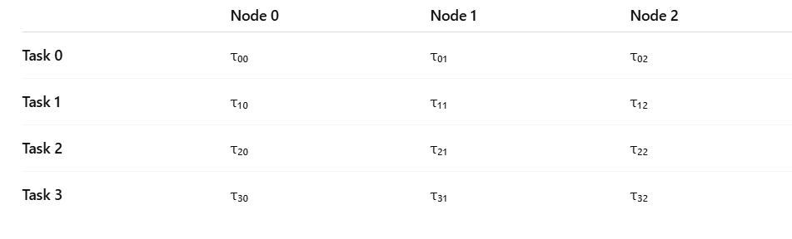
Initialize pheromone

Slide 16
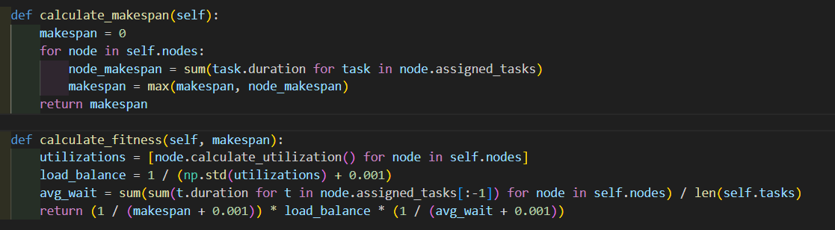
Objectives(fitness)
Makespan Inverse: It rewards shorter total completion time (makespan) — the lower it is, the higher the fitness.
Load Balance: It uses the inverse of the standard deviation of node utilizations to favor evenly loaded nodes.
Average Wait Time: It penalizes long task wait times by including the inverse of the average wait per task.

Slide 17
AS, ACS, EAS, MMAS, Asrank, ACO-GA
AS (Ant System):
Original ACO model.
All ants contribute to pheromone update.
Simpler, but may converge slowly.
ACS (Ant Colony System):
Uses local pheromone updates and a pseudo-random rule for exploration.
Faster convergence but risks getting stuck in local optima.
EAS (Elitist Ant System):
Same as AS but adds extra pheromone from the best-so-far ant.
Improves convergence speed.

Slide 18
AS, ACS, EAS, MMAS, Asrank, ACO-GA
MMAS (Max-Min Ant System):
Strong focus on controlling pheromone bounds (min/max).
Updates pheromone from only the best ant.
Robust and avoids stagnation.
ASrank (Rank-based Ant System):
Uses a ranking system where top ants contribute pheromone in proportion to their rank.
Balances exploration and exploitation.
ACO-GA (Hybrid ACO with Genetic Algorithm):
Combines ACO’s path construction with GA’s evolutionary operators (crossover, mutation).
Better global search and diversity but higher complexity.

Slide 19
ACO and GA
The Hybrid ACO-GA algorithm combines the strengths of Ant Colony Optimization (ACO) and Genetic Algorithm (GA) to enhance performance in complex optimization tasks such as task scheduling, resource allocation, and combinatorial optimization.
ACO contributes strong exploitation via pheromone-guided search.
GA contributes robust exploration via crossover and mutation of diverse solutions.
ACO Phase: Each ant constructs a solution based on pheromone trails and heuristic info.
GA Phase: Apply crossover and mutation to generate new candidate solutions.

Slide 20
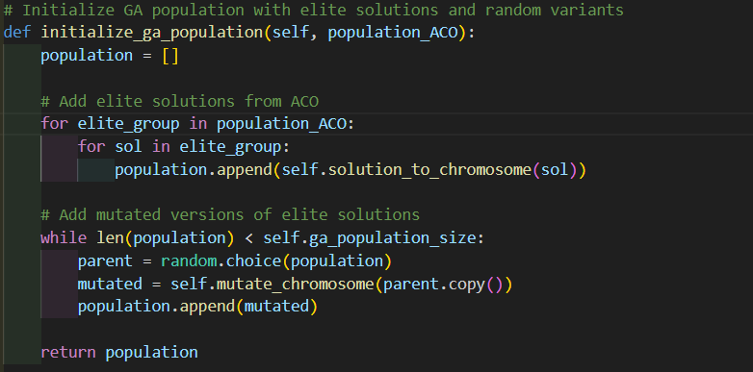
Initialize population
This method initializes the Genetic Algorithm (GA) population by incorporating high-quality solutions from the ACO phase, ensuring a strong starting point for the evolutionary process.
Converted the solutions into GA chromosomes

Slide 21
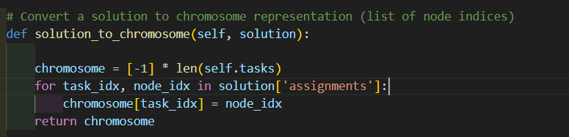
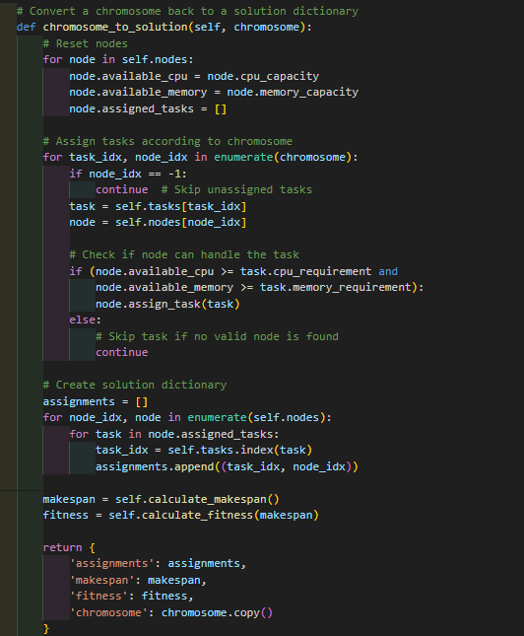
solution to chromosome and chromosome to solution

Slide 22
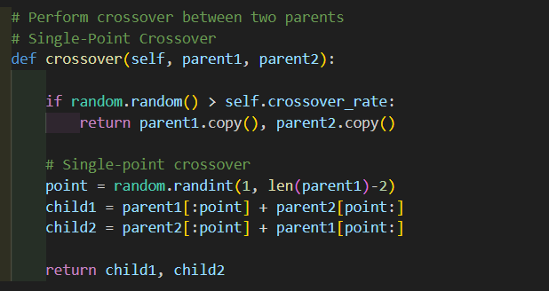
crossover
This function performs a single-point crossover between two parent chromosomes during the Genetic Algorithm (GA) phase to generate new offspring.
Crossover Probability Check:
With a probability defined by crossover rate, crossover is performed.
If not triggered, the original parents are returned unchanged (preserving good solutions).
Single-Point Crossover:
A random crossover point is selected (excluding the first and last positions).
Two new children are generated by swapping the tails of the parents at that point.

Slide 23
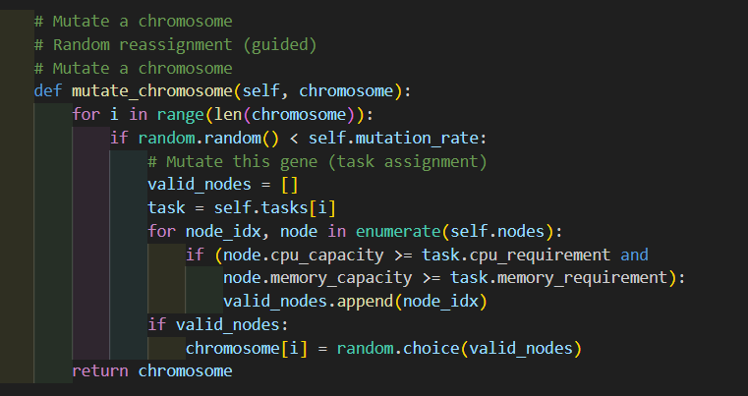
Mutation
This function performs mutation on a GA chromosome by randomly reassigning task-to-node mappings, while respecting system constraints.
Gene-Wise Mutation Check:
For each task assignment (gene), a mutation is applied with probability mutation rate.
Constraint-Aware Reassignment:
A new node is selected randomly from a list of valid nodes that can handle the task’s CPU and memory requirements.
This ensures all mutated solutions remain feasible and valid.

Slide 24
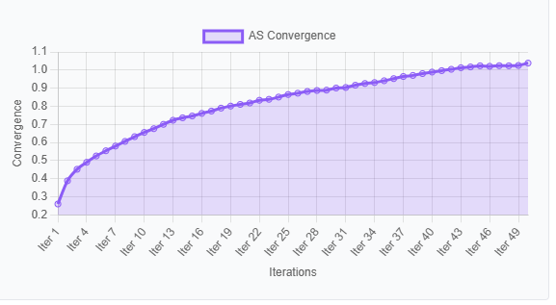
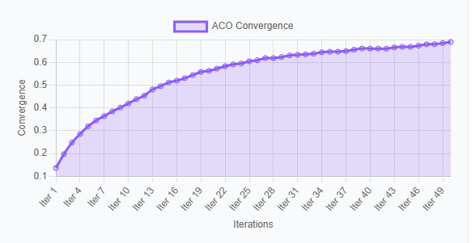
Pheromone Convergence

Slide 25
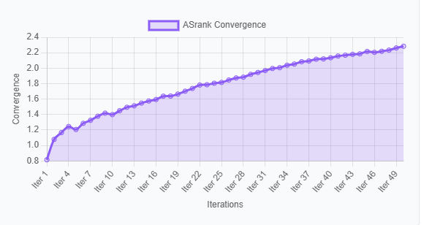
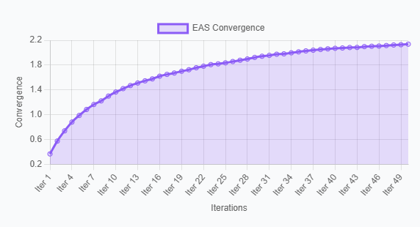
Pheromone Convergence

Slide 26
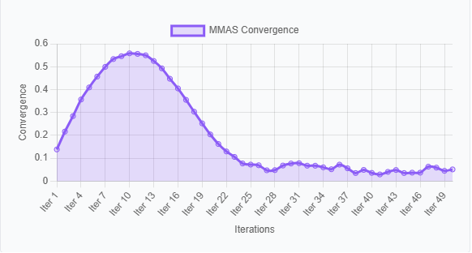
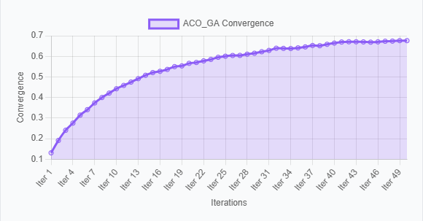
Pheromone Convergence

Slide 27
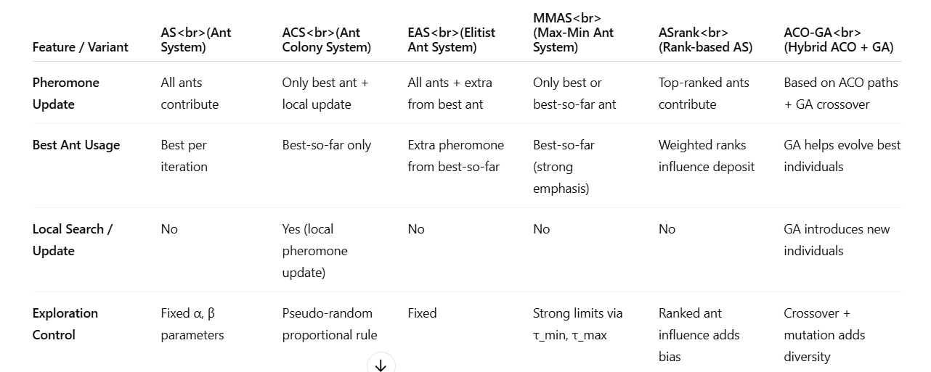
summary

Slide 28
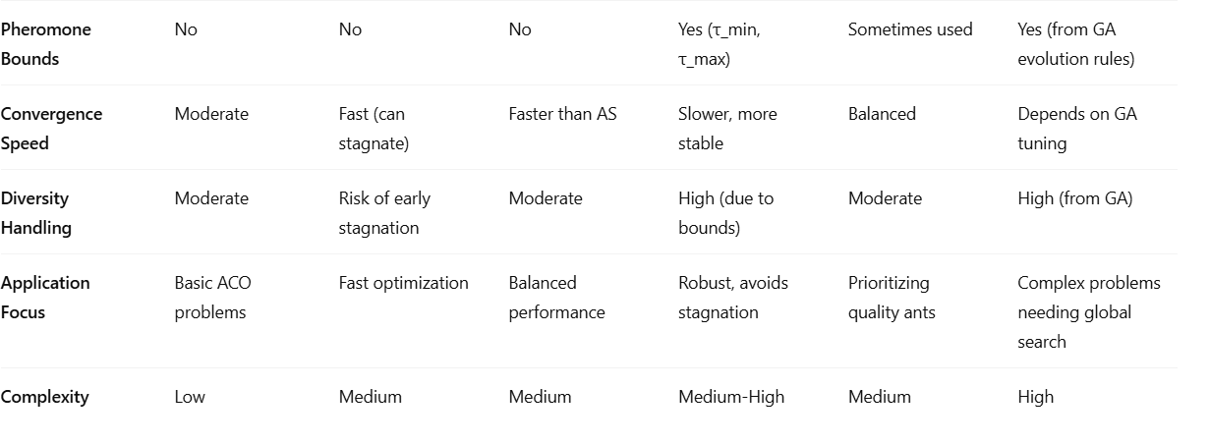
summary

